Slide 1
WEB DEVELOPMENT PROJECT
SocSpecs: A Comparative Analysis and Visualization of Processor Specifications
Name: Abhay Raj
Guru Tegh Bahadur Institute of Technology
Date: 14-11-24

Slide 2

Certificate
Programming with JavaScript provides a comprehensive introduction to JavaScript, covering essential topics for beginners and those looking to strengthen their JavaScript foundation. The course emphasizes the practical applications of JavaScript for web development, enabling participants to create interactive, dynamic content for websites.

Slide 3
Introduction
SocSpecs is a platform designed to provide users with comprehensive specifications and performance comparisons of System on Chips (SoCs). It serves as an accessible resource for tech enthusiasts, professionals, and anyone interested in the technical details and benchmarks of modern processors.
To offer in-depth insights into processor capabilities, enabling users to make informed decisions based on real-world performance data.
Built with a client-server architecture utilizing Next.js for the frontend, PostgreSQL for database management, and Tailwind CSS for responsive design.

Slide 4
SYSTEM DESIGN

Slide 5
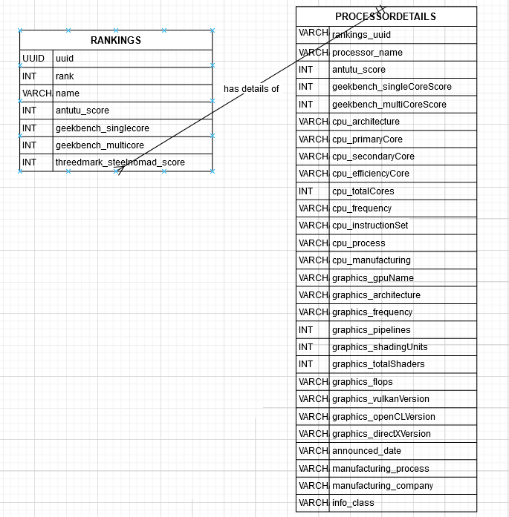
ER-DIAGRAM
RANKINGS Table: Stores overall ranking information, including unique identifiers, benchmark scores, and the processor name. It has a one-to-one relationship with PROCESSORDETAILS, where each rank entry corresponds to a processor.
PROCESSORDETAILS Table: Contains detailed technical information for each processor, including CPU and GPU details, performance scores, manufacturing information, and announcement dates.

Slide 6
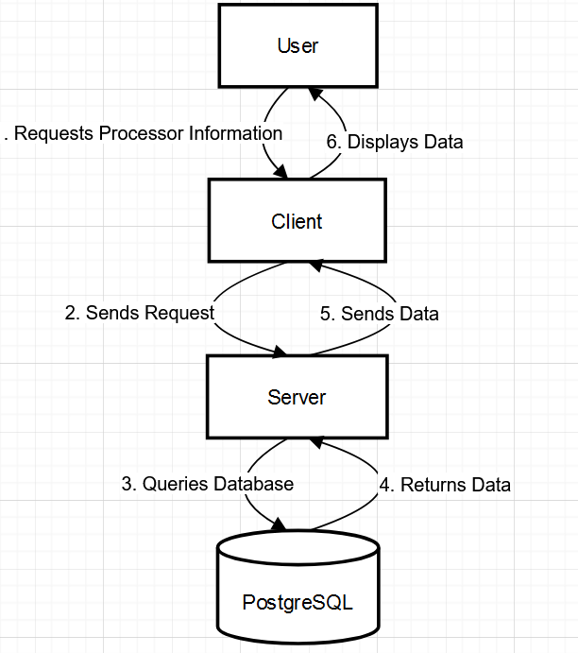
Data Flow Diagram
The user initiates a request on the client interface (e.g., searching for a processor or comparing SoCs).
The client sends this request to the server.
The server queries the PostgreSQL database based on the request.
The database returns the relevant data to the server.
The server processes and sends the data back to the client.
The client displays the information in a readable format for the user.

Slide 7
UI DESIGN & WALKTHROUGH

Slide 8
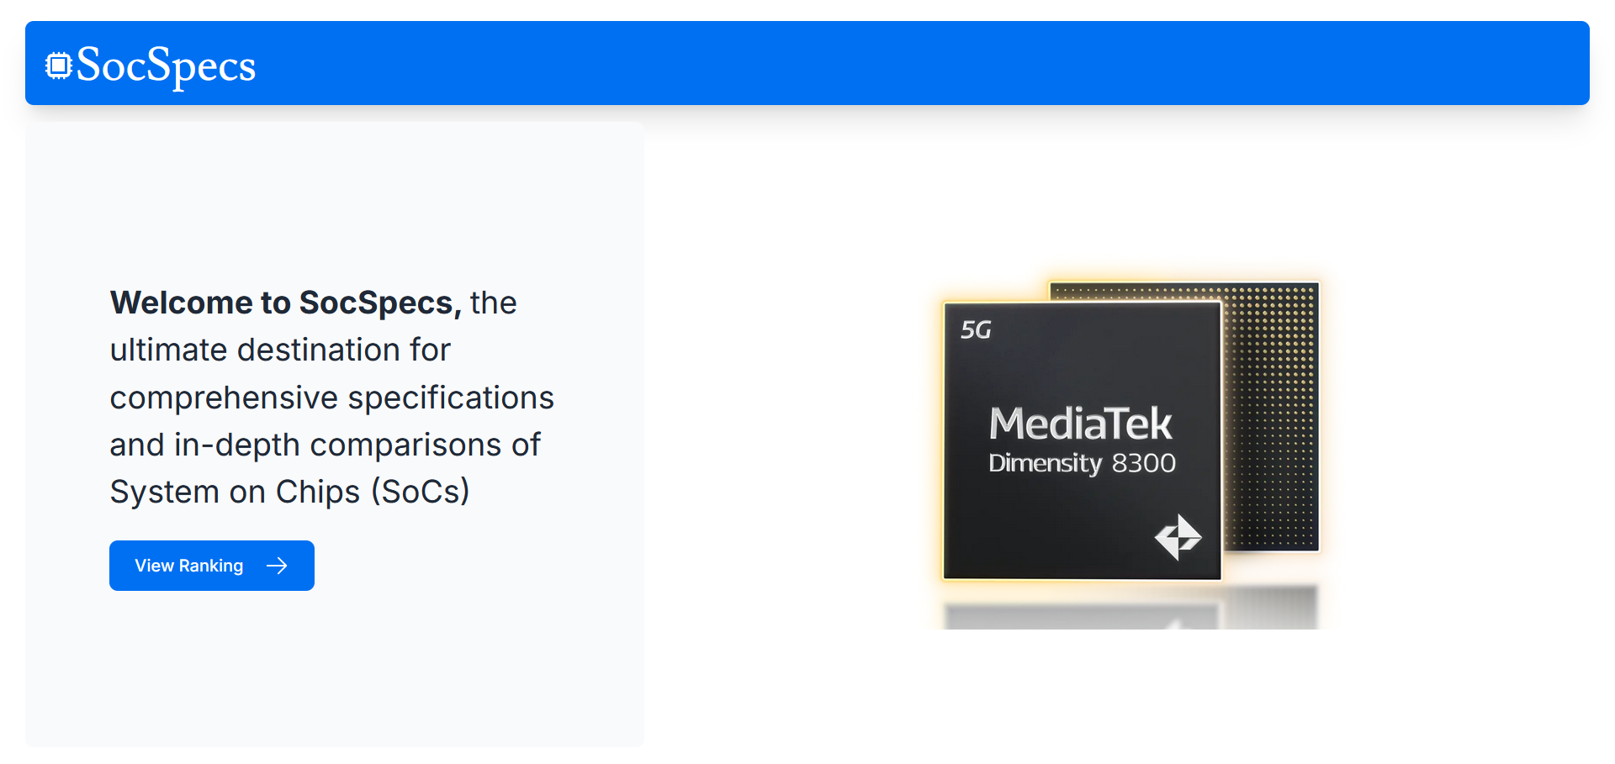
Desktop View:
Landing Page:
The landing page includes the processor image, introductory text, and a View Ranking button for easy navigation.

Slide 9
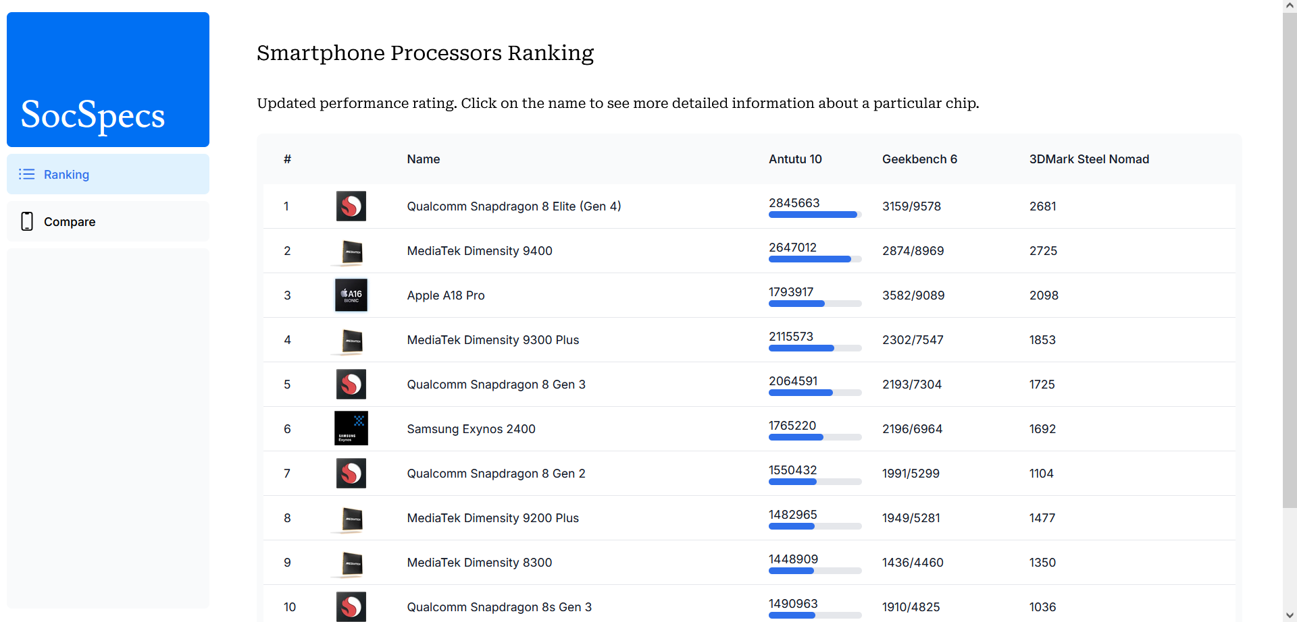
Desktop View:
Ranking Page:
The rankings table is visible on the page with sortable columns and clear ranking information.

Slide 10
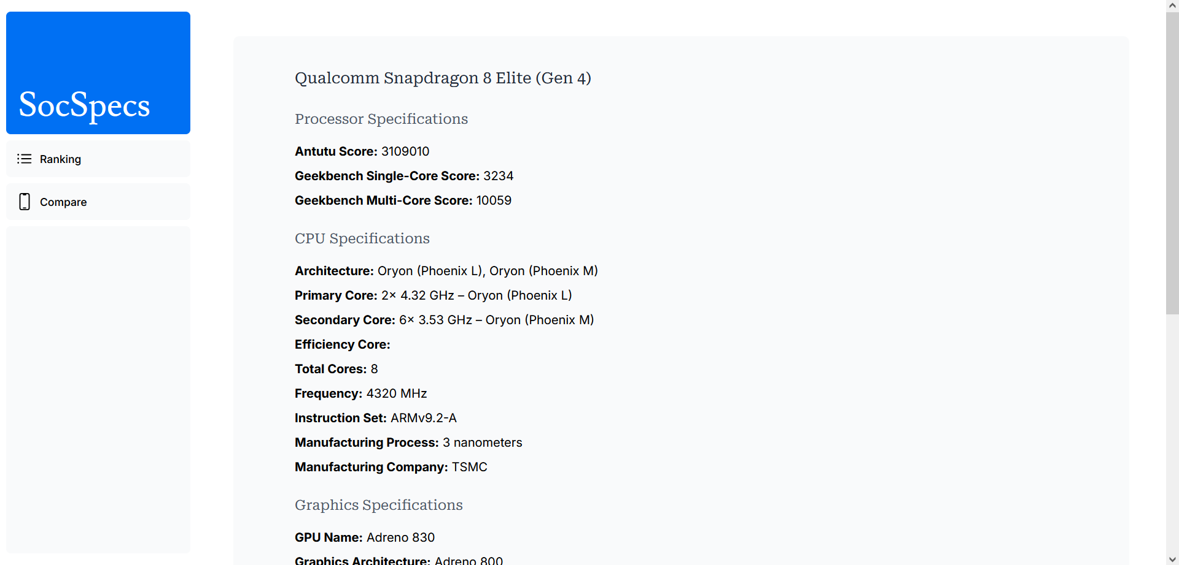
Desktop View:
Processor Details:
The processor details page includes comprehensive specifications, including Antutu Score, Geekbench Scores, CPU and GPU specifications, and general information like the manufacturing process.

Slide 11
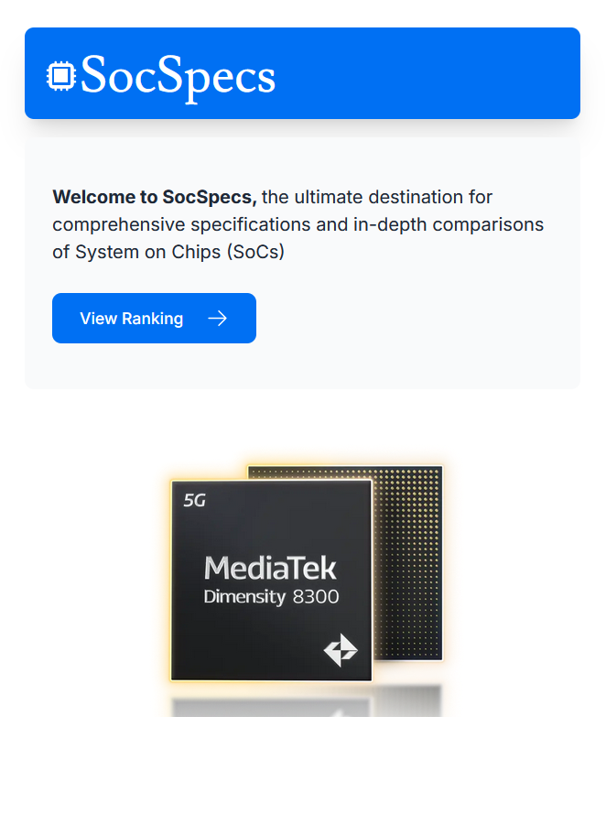
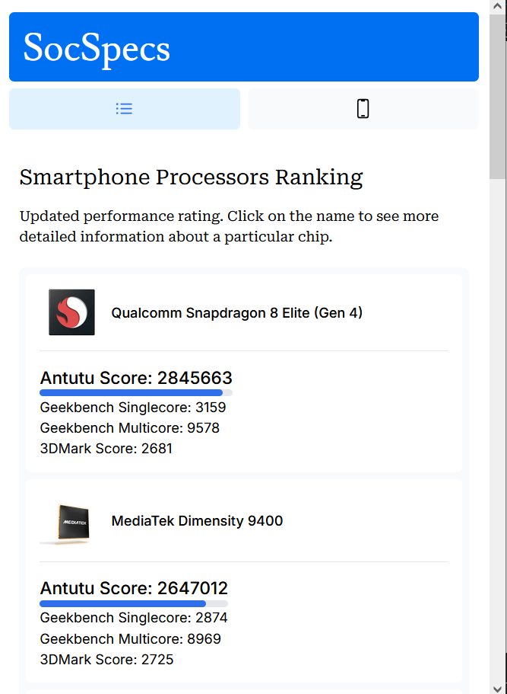
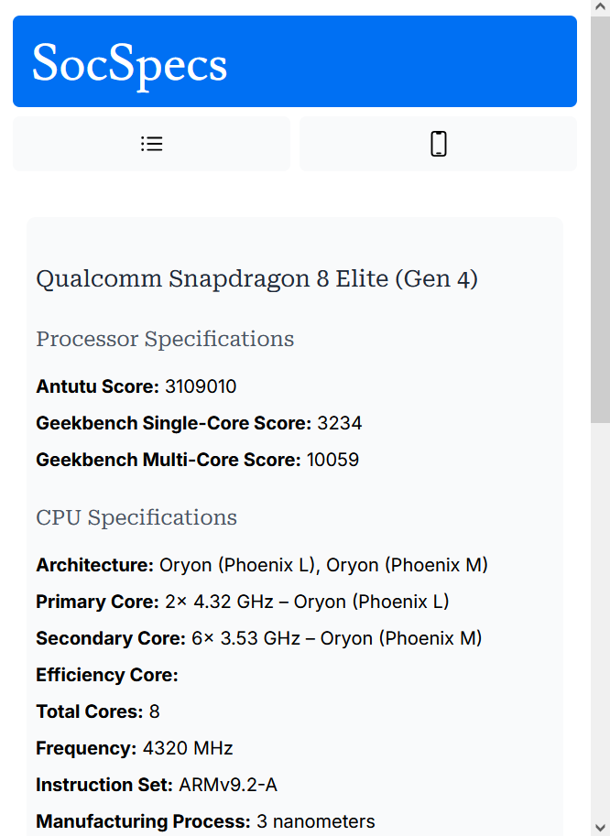
Mobile View
Landing Page:
Ranking Page:
Processor Details:

Slide 12
Conclusion
The SocSpecs project achieved its goal of providing a detailed platform for comparing and analyzing System on Chips (SoCs) with accessible, in-depth processor data and rankings.
Successfully designed a client-server architecture, implemented a relational database schema, and created a user-friendly interface with responsive design for mobile and desktop. Key features include processor details, ranking comparison, and rich graphical data visualization.

Slide 13

Thank you
CC by SA, Risyad Rais

